Slide 1
Face Recognition
Devanshi Piprottar(131009)
Shivani Shah(131051)
Suhani Ladani(131057)
Jagat Panchal(1521002)
Parth Thakkar(1521007)

Slide 2
Techniques used
Detection: Haar cascade
Tracking: CamShift
Recognition: LDA
KNN for classification

Slide 3
Creating database and training
Database of images is created (high quality as well as low quality)
All the images in a particular folder are appended into a single array
All the same image array is given one particular index as y
x, y and corresponding subject names are saved

Slide 4
Recognition
Face is detected from the video, and region of interest is extracted.
Prediction model helps to identify the associated label with the face.
Fisher face representation of the faces is made use to compare the faces from the video.

Slide 5
Thresholding
The distance from the fisher face of each class is compared, if the given thresholding condition value is satisfied, corresponding label is given.
Thresholding is greatly affected by luminosity, thus care must be taken to create a database that includes variations.

Slide 6
Labelling
Labelling theory is for self-identity
Behaviour of individuals may be determined or classify them
Issue was related to distinction multiple face label

Slide 7
Advantage of LDA
LDA is used due to below given reasons:
Based on Fisher face projection approach to solve the illumination and expression variation
Optimization in low dimension subspace
Achieves well by maximizing the between-class scatter while minimizing the within-class scatter
Effective for large training database (Therefore our database size we have kept of 80 images)

Slide 8
Advantages of techniques used
Viola jones: Real time detection of faces
Camshift: Gives better results in noisy environment without filtering or adaptive smoothing.
K nearest neighbors: Robust to noisy environment and effective towards large data sets

Slide 9
Problems Faced
Threshold changes with luminous intensity, which creates false positives, miss detection.
It is difficult to set a threshold for unknown.
The speed could be a problem.
We had faced issues in labeling(passing the label).

Slide 10
Solutions
Quality of the database and video is important.
To increase the speed make sure to train the data only once and then use that data.
Tracking to avoid recursive detection and recognition on each frame to increase speed.

Slide 11
Trade off
There is a trade off between the speed and accuracy.
When we try to increase the speed, there are a few false positives and negatives.
In case of full HD with 100% accuracy, we could get around 18-20 frames per second.
Thus we have to set the parameters to get the highest accuracy, and at the same time as much speed as possible.

Slide 12
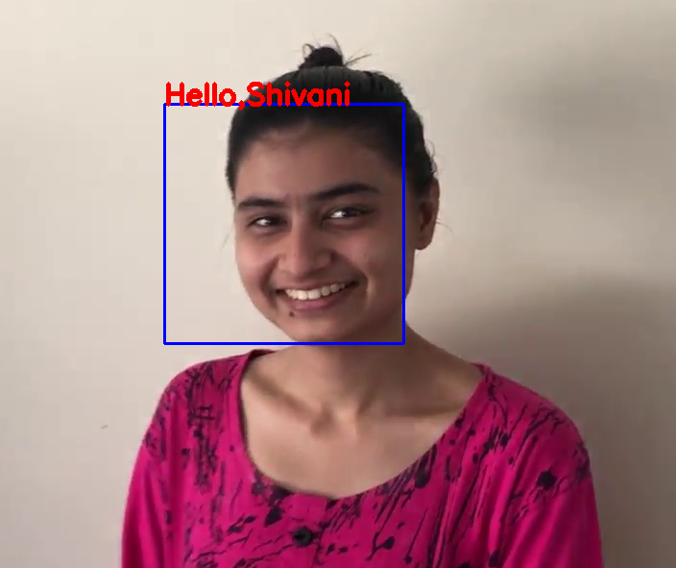
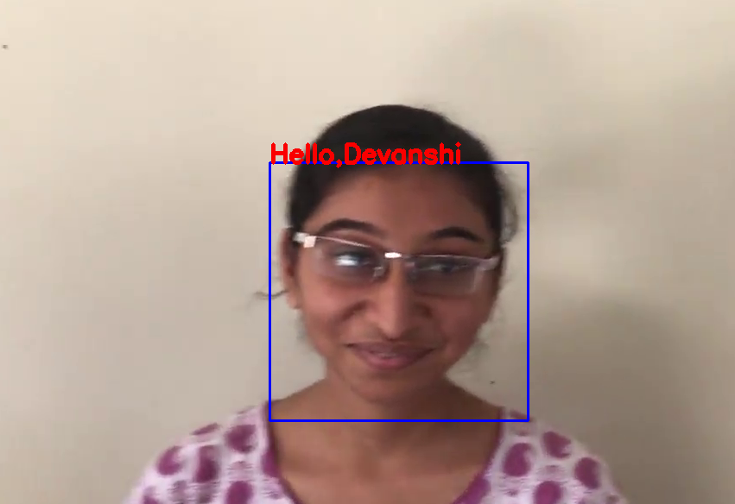
Results (on video-1280x720)

Slide 13
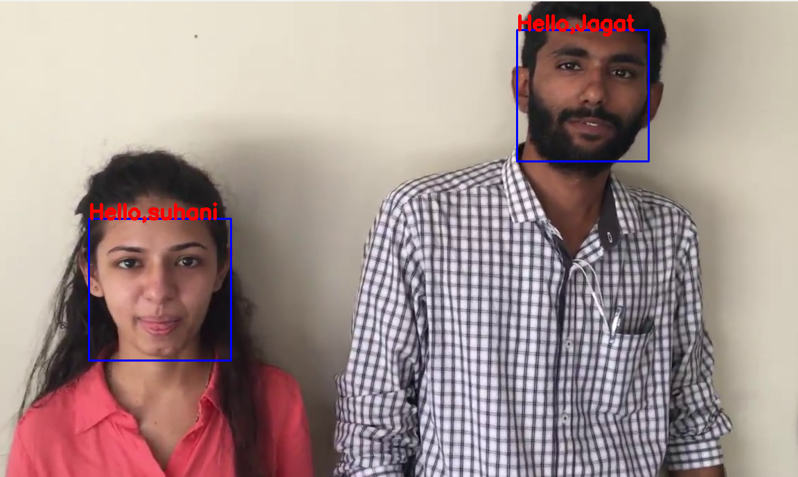

Slide 14
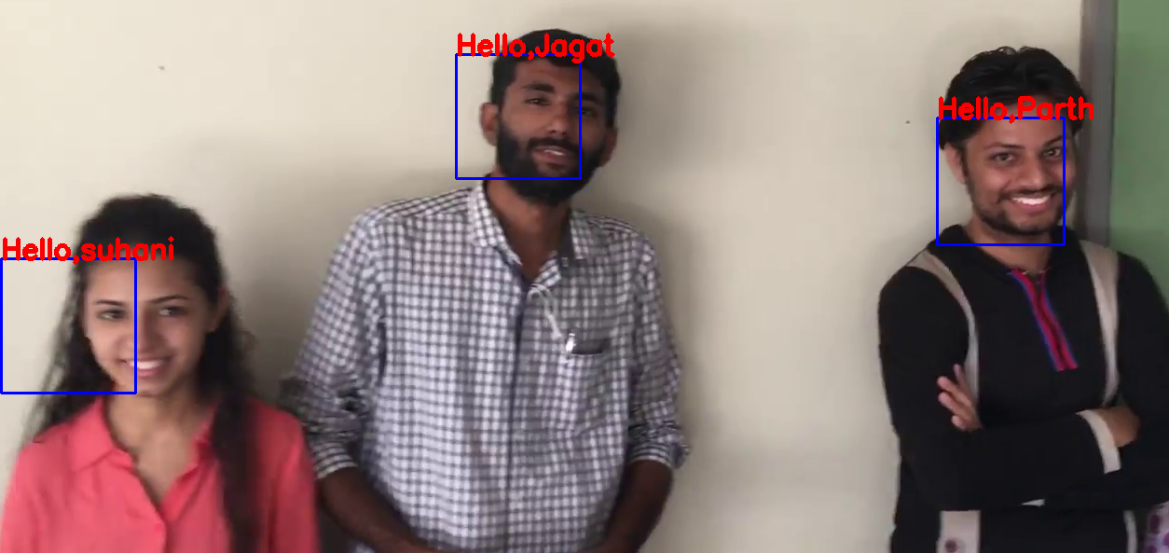
Multiple face recognition

Slide 15
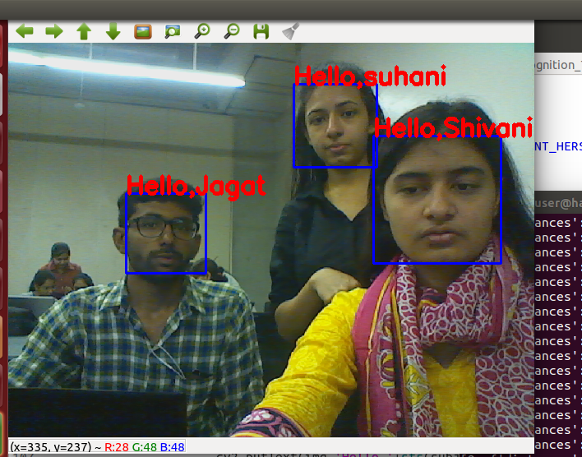
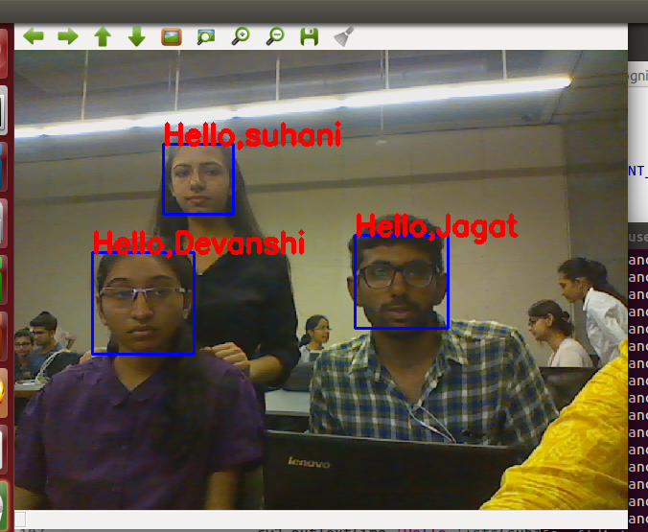
Results (on webcam)

